Slide 1

Implementing a Shadow Stack

Slide 2


Context
📖 RISC-V is an open-source RISC Instruction Set Architecture​
🔃 In our current project, we are studying an example of attack, aiming to disrupt the Control-Flow Integrity
🏰 The goal of the project is to study this technique
and implement a hardware security extension.​

Slide 3

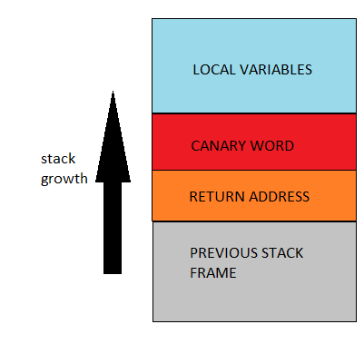
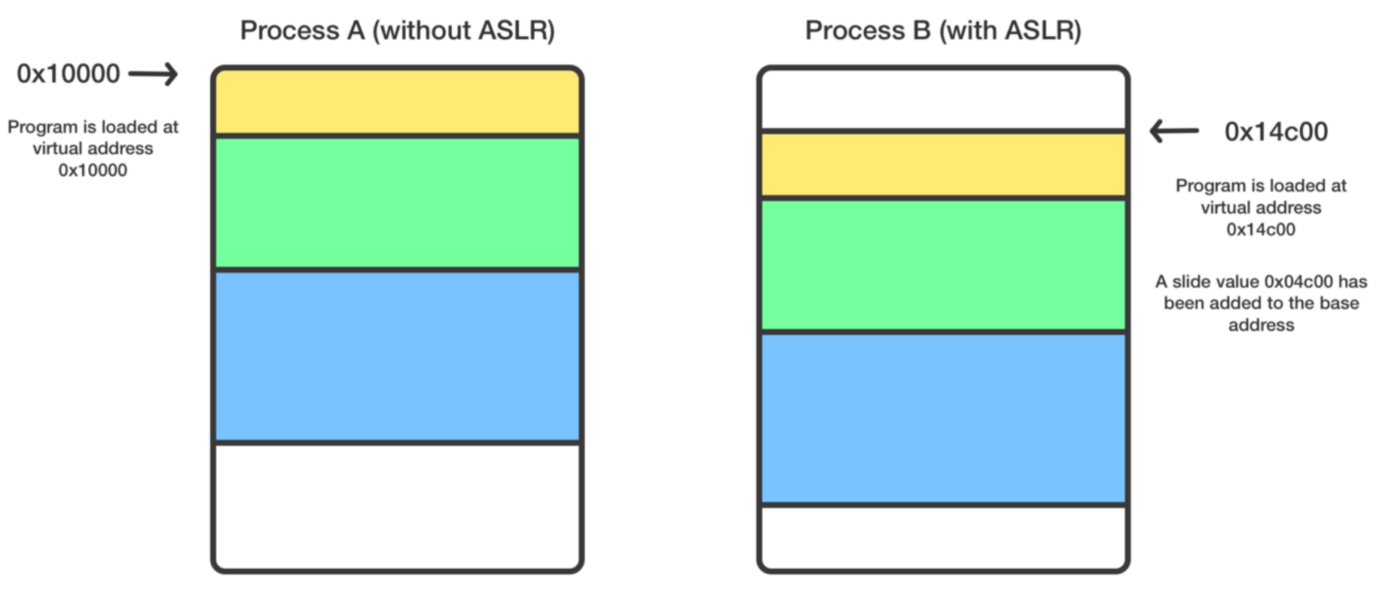
Protection mechanisms: stack canaries & address space layout randomization
Random values are placed inside the
stack frames before the return addresses.
Integrity of the canary is checked before return.
In case of buffer overflow, the canary is corrupted.
Address space positions of key data areas are
randomly rearranged.
Exploitation of buffer overflow is complicated
as the attacker doesn’t know where to jump.
ASLR [1]

Slide 4
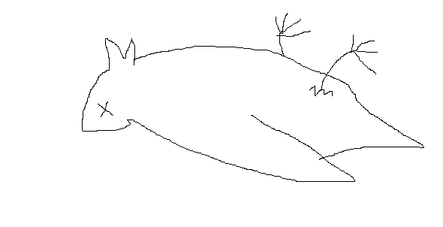
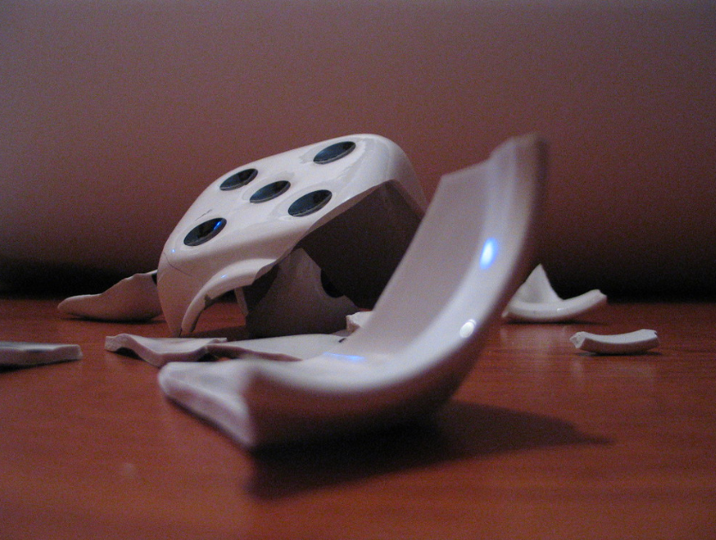
Issues with these mechanisms
Server : the process is forked each time a connection is initialized.
ASLR can be bypassed using many tricks.
An easy way is to use a big nopsled and brute force until falling into.
The process is literally duplicated including the canaries.
Canaries can then be brute-forced byte by byte.

Slide 5
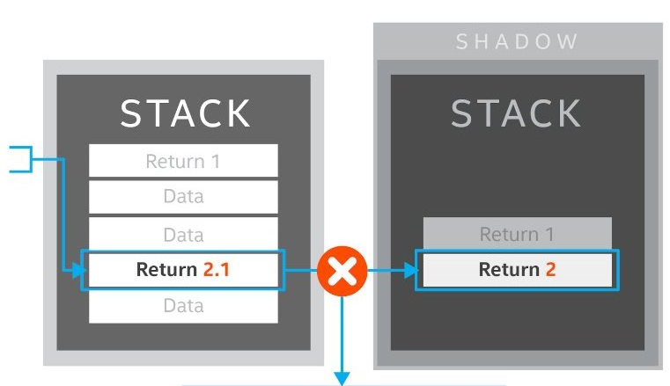
Shadow stack mechanism
The return address is duplicated and pushed into another stack (the shadow stack) at each function call.
When returning from a function, the address to which we jump is compared to the one stored in the shadow stack.
If the addresses differ, we know that the return address has been overwritten.
Shadow Stack [2]

Slide 6
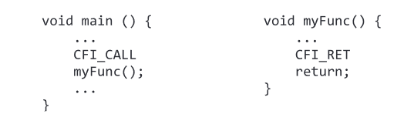
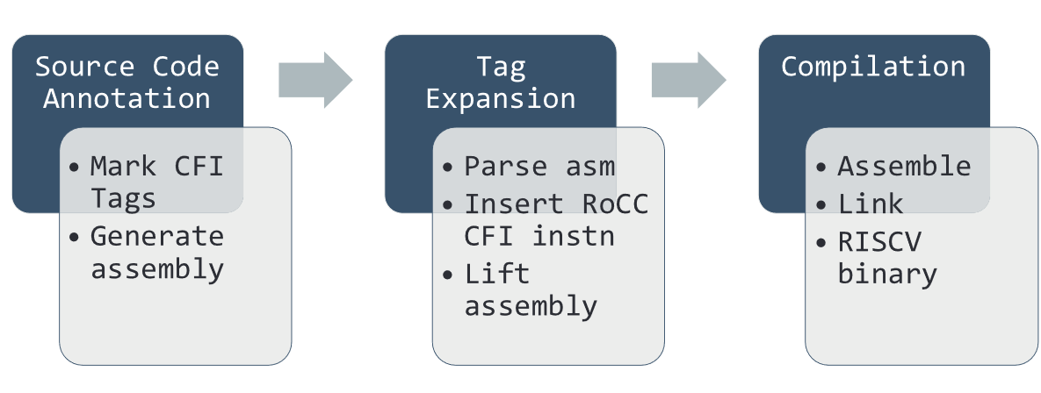
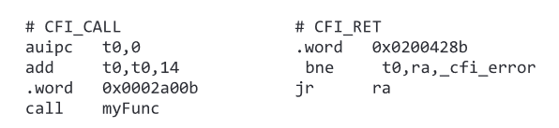
The Rocket Custom Coprocessor approach
Control Flow Integrity (CFI) tags are placed before function calls and returns.
Those tags are then expanded into actual instructions through the RoCC.
The final assembly code is compiled.
CFI enforced compilation process [3]
Tags expansion into instructions [3]
[3]
De et al.(2019), Hardware Assisted Buffer Protection Mechanisms for Embedded RISC-V, The Pennsylvania State University

Slide 7
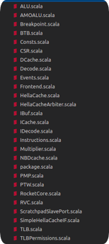

First attempt: rocket generator
Scala generating some verilog.
Usable with LiteX (easy to run on boards)
Some interesting options:
scie/SCIE.scala
instructions.scala

Slide 8
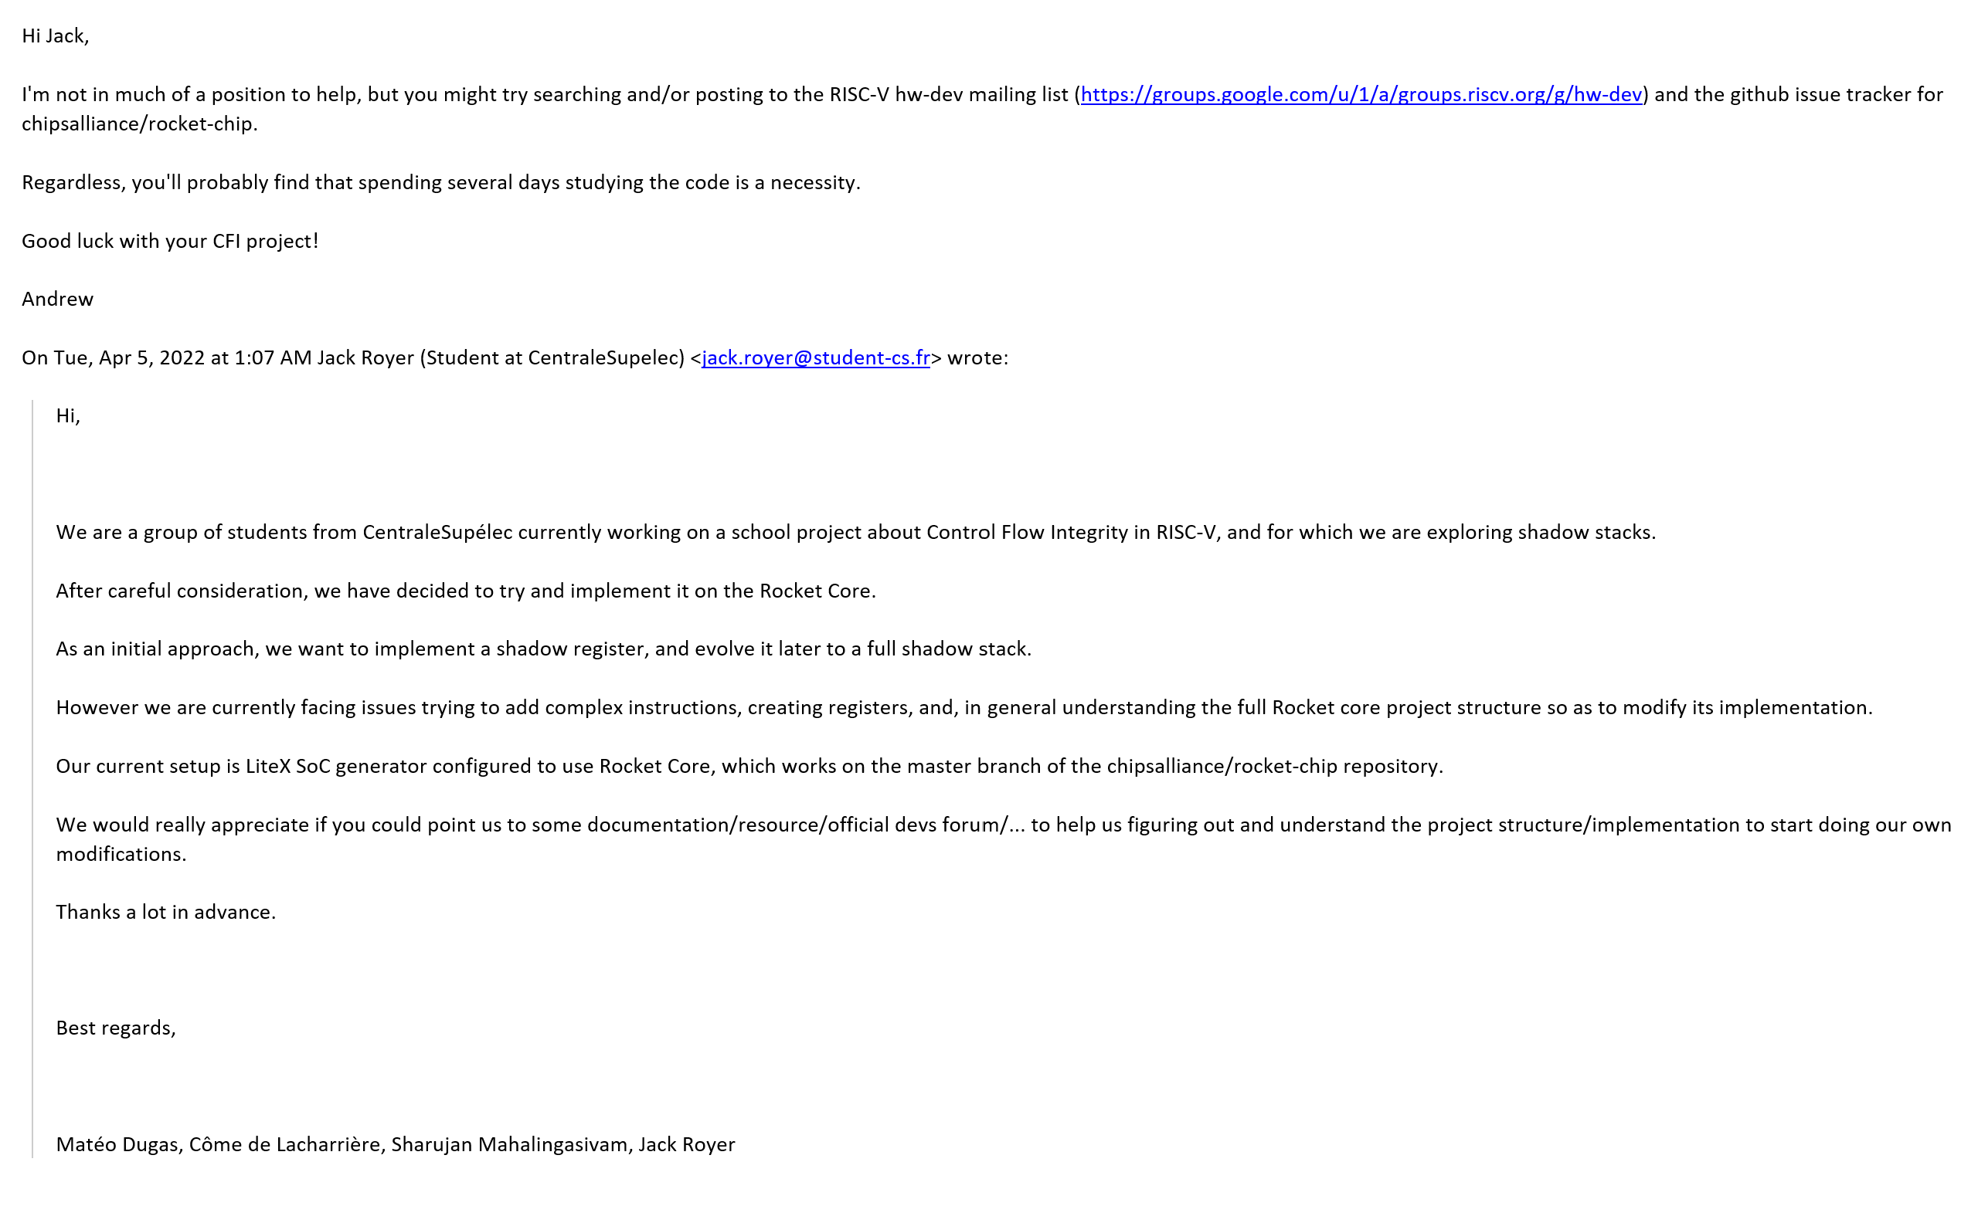
Why we stopped
🤔 Using a new language (Scala), with unique paradigms and with a somewhat obscure Domain Specific Language (DSL) (Chisel).
🚀Rocket is a CPU Generator. This adds unnecessary complexity to our project.
📚 Lack of documentation.
📧 Lack of support.

Slide 9
Alternatives
 | VEX – RISCV | NEORV32 | Spike Simulator
📚 Documentation | Plenty | Plenty, user friendly and beautiful | Exists
💭Language | VHDL | VHDL | C
🤔 Complexity | Normal | Easy (Similar design to MA course) | Seems Easy
⚡ Ran on our boards | YES (using LiteX) | YES | Not applicable
✨ Bonus | - | Entire SoC, not only a CPU. | No board
💖

Slide 10
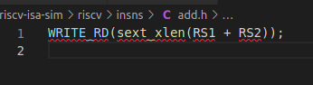
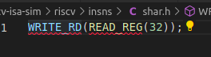
Spike simulator
Spike simulator
Following a tutorial: mod instruction.
Unfortunately, each step of programming and testing requires the rebuild of the RISC-V toolchain, which a long process.
(1 hour of 100% CPU)
And this process often led to a bunch of obscure errors.
This is where we stand regarding this solution :
Too long debugging steps
Undocumented errors

Slide 11

Running on the boards
Once we chose NEORV32, we had to run it on our boards :
Run the .tcl script which creates a Vivado project
Run Bitstream generation
Flash .bit onto the board
Open UART connection with the board
Launch make exe on a code example
Send the .exe file onto the board
Admire the result 😍
“The NEORV32 Processor is a customizable microcontroller-like system on chip (SoC) that is based on the RISC-V NEORV32 CPU.”

Slide 12
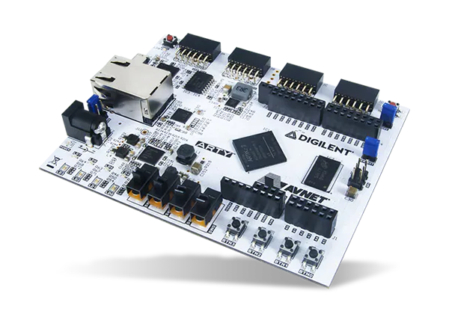
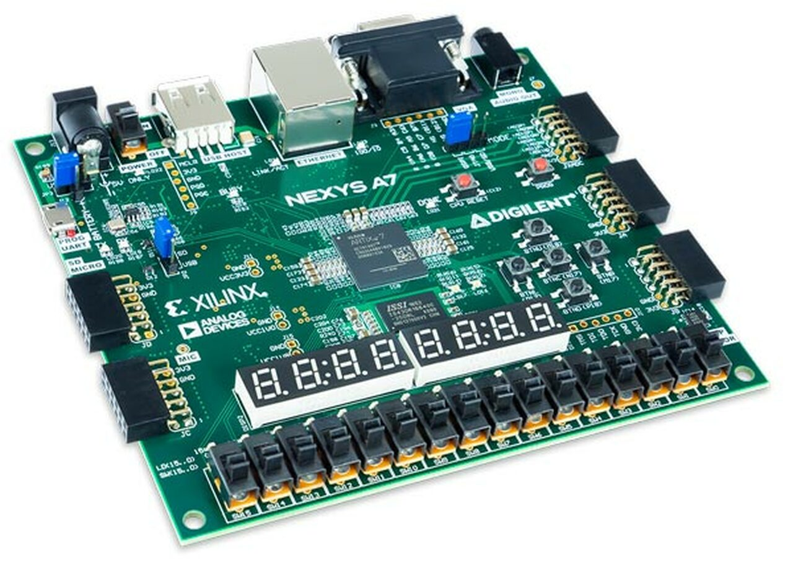
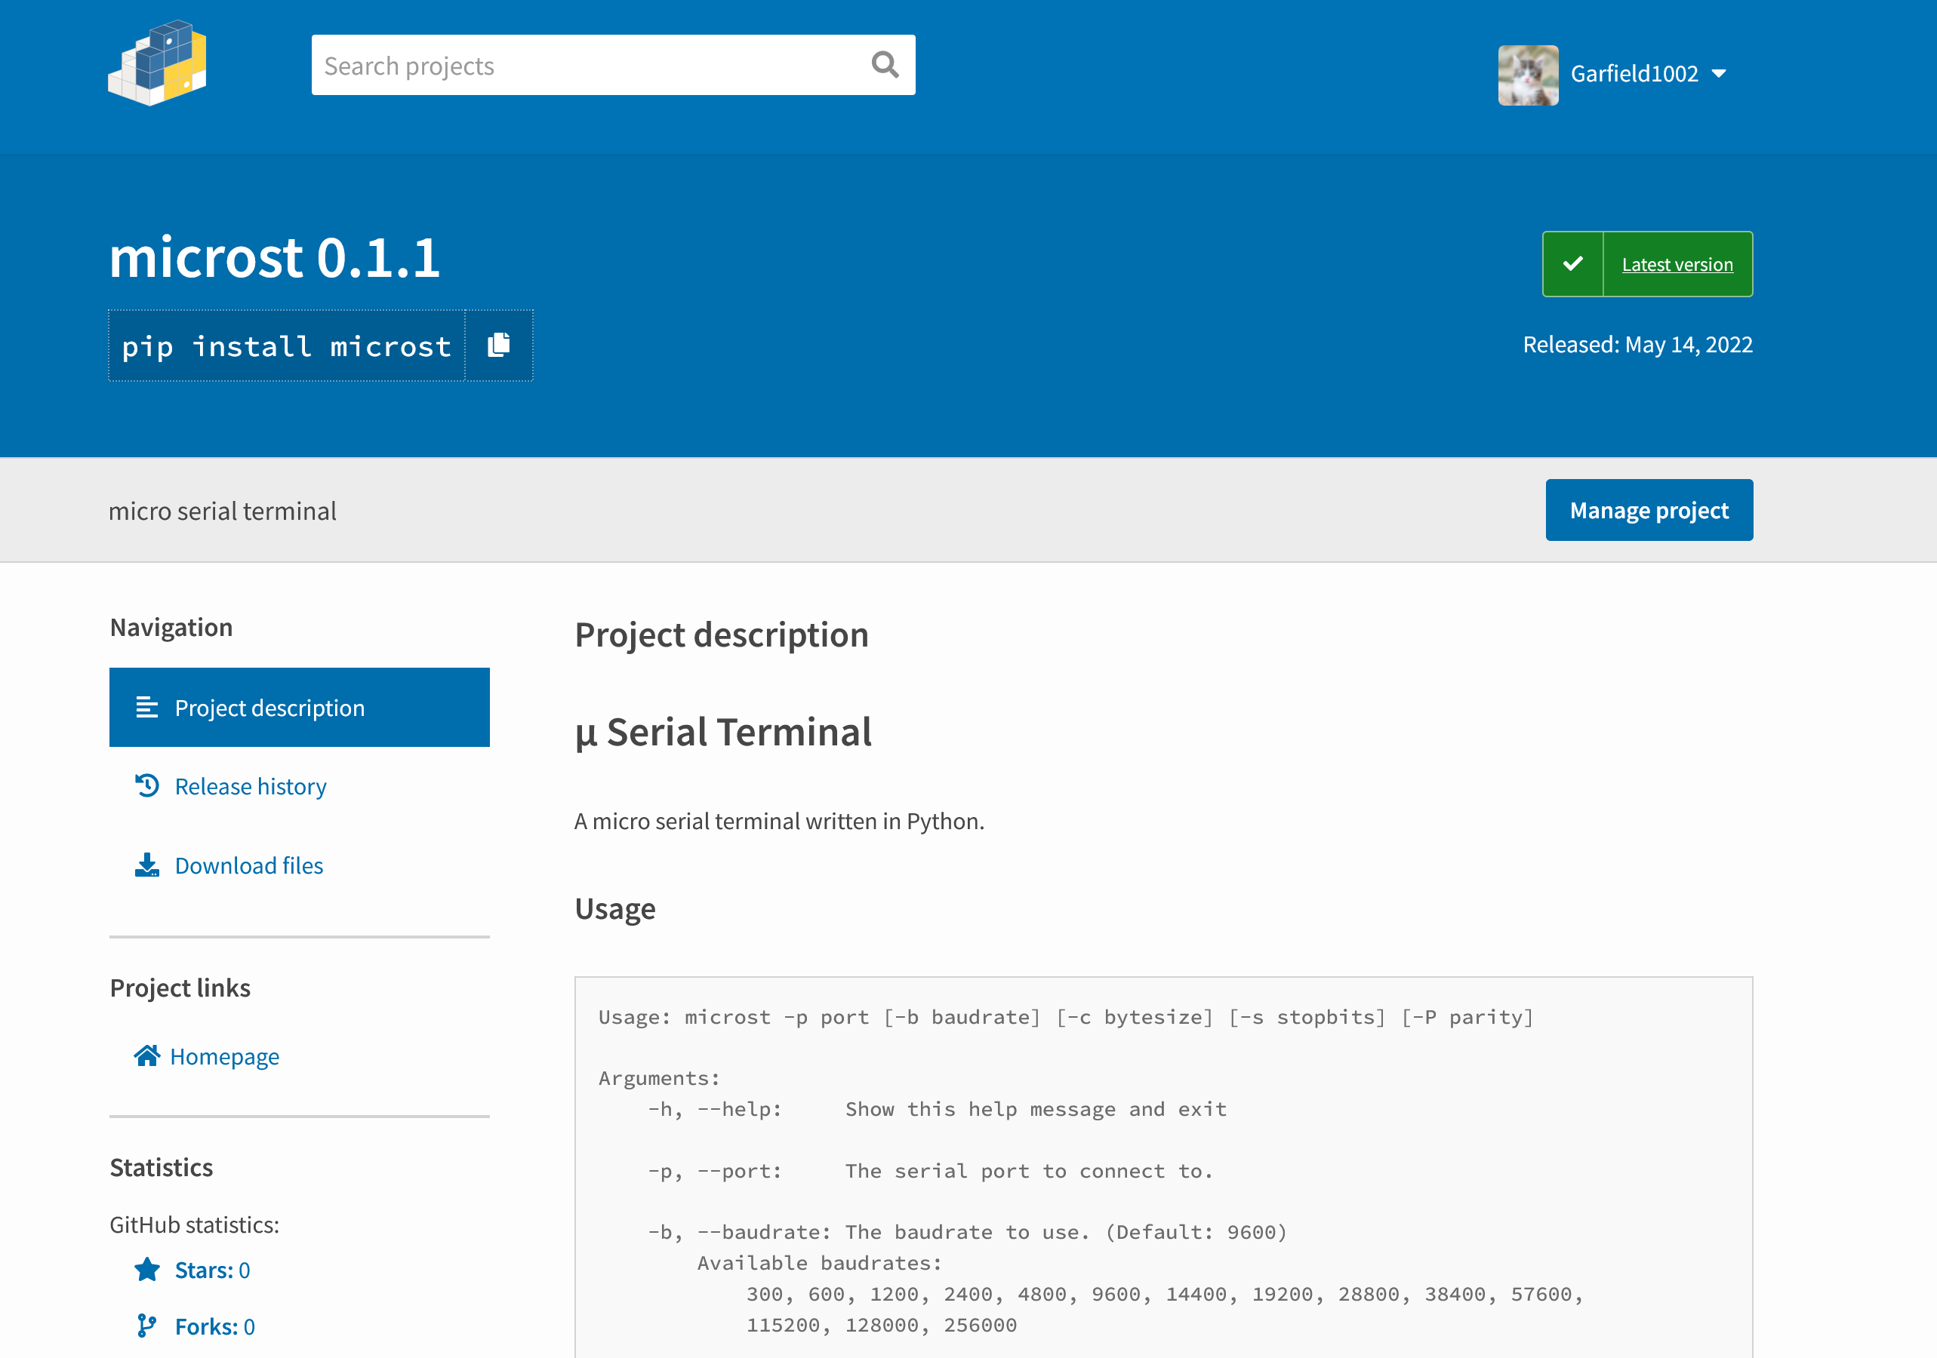
Running NEORV32
💾 We managed to have NEORV32 running both on the Nexys A7 as well as the Arty A7 (previously not supported)
🔌 In order to open a UART connection we used CuteCom on Linux and developed MicroST for Windows

Slide 13
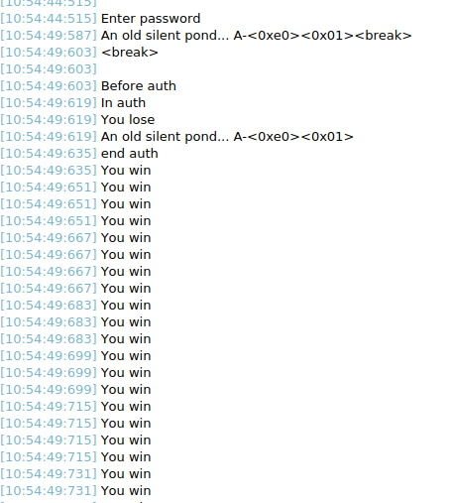
The attack
During the previous semester, we developed an attack that overwrites the return address to execute code that shouldn’t be runnable without the password.
We adapted and ran it on NEORV32

Slide 14
The shadow stack: our implementation
Shadow stack
0x100
0x245
0x9c4
0x314
UUU
✨ Model:
255 registers to store return addresses 1 register to store the nested depth
📥 Jumping in :
Store the return address Increment the nested depth
📤 Jumping out :
Compare the return address with ours Decrement the nested depth
⬅ (current) RA

Slide 15
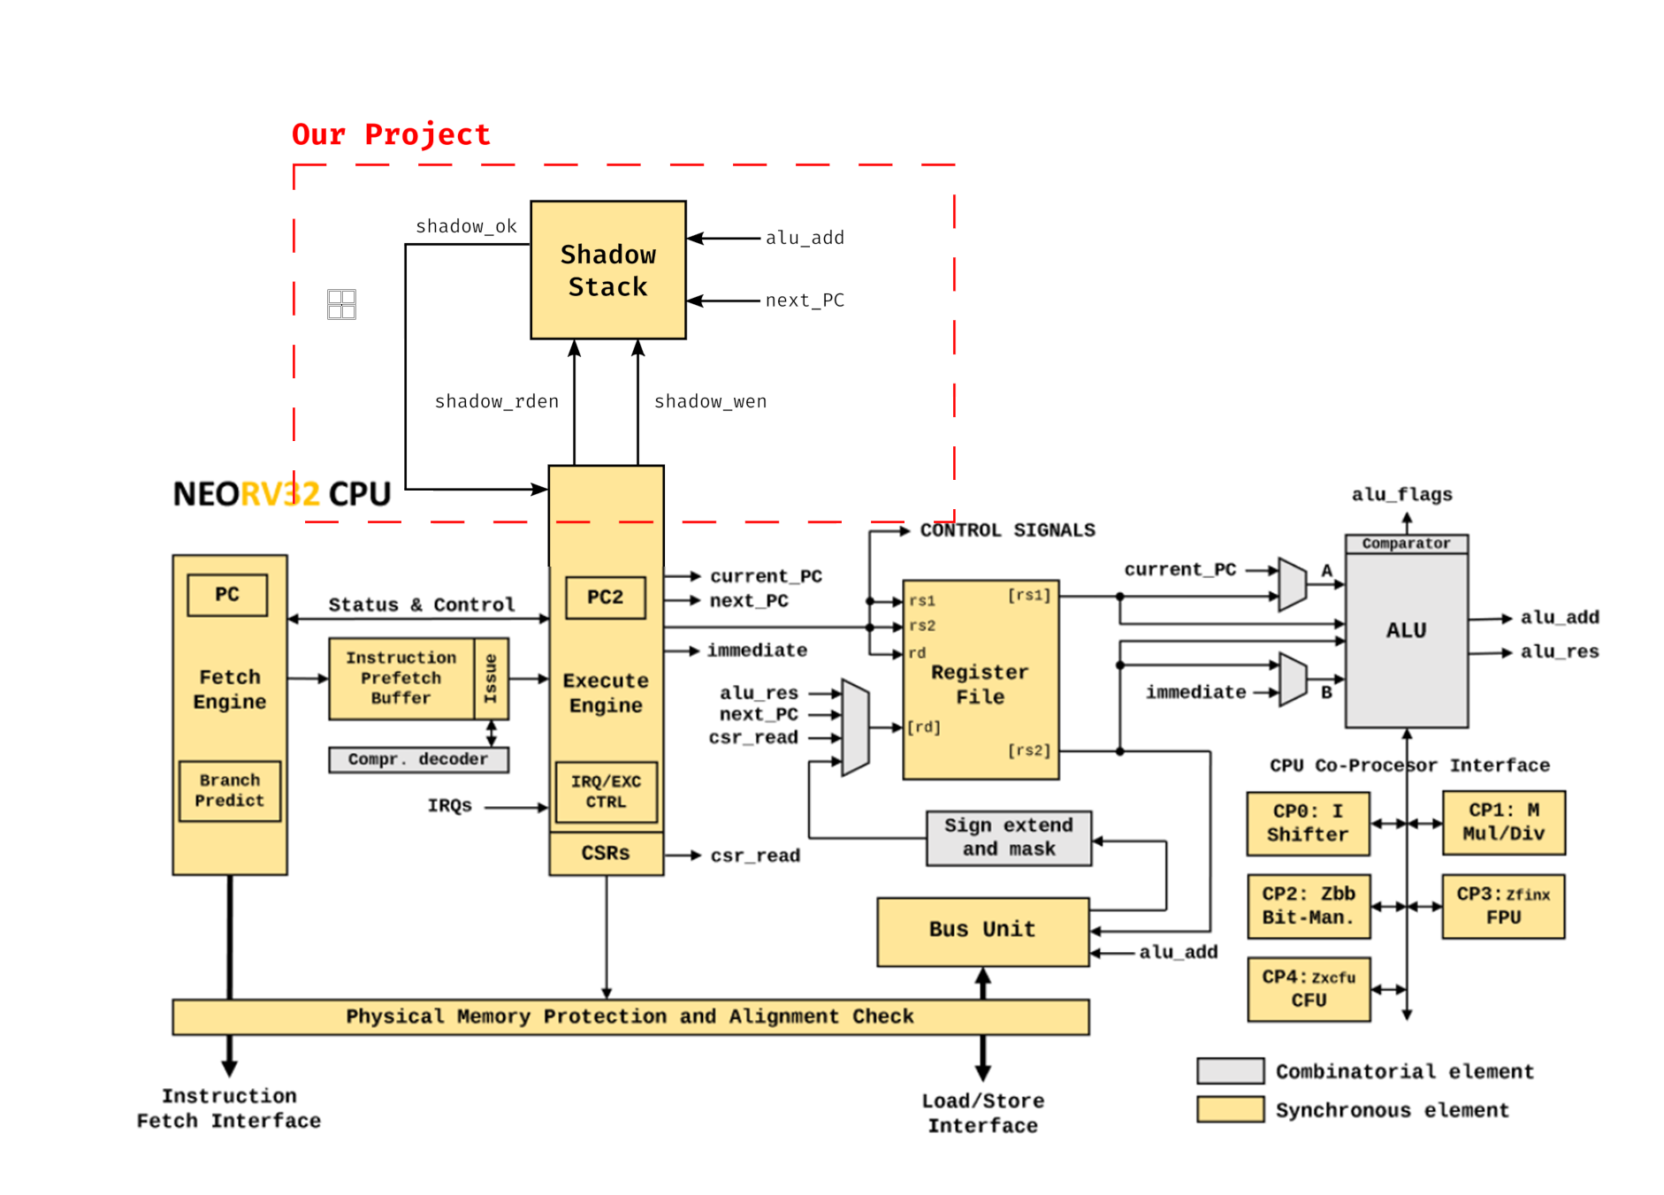
The shadow stack: our implementation

Slide 16
Experiments
After creating the shadow stack, we needed to be able to test our implementation.
The goal was to check if the entity was used correctly.
We used the testbench provided by NEORV32
The behaviour is not corrupted by the presence of the entity
The stack is written into and read from
Could not test the bootloader in simulation so unable to debug.

Slide 17
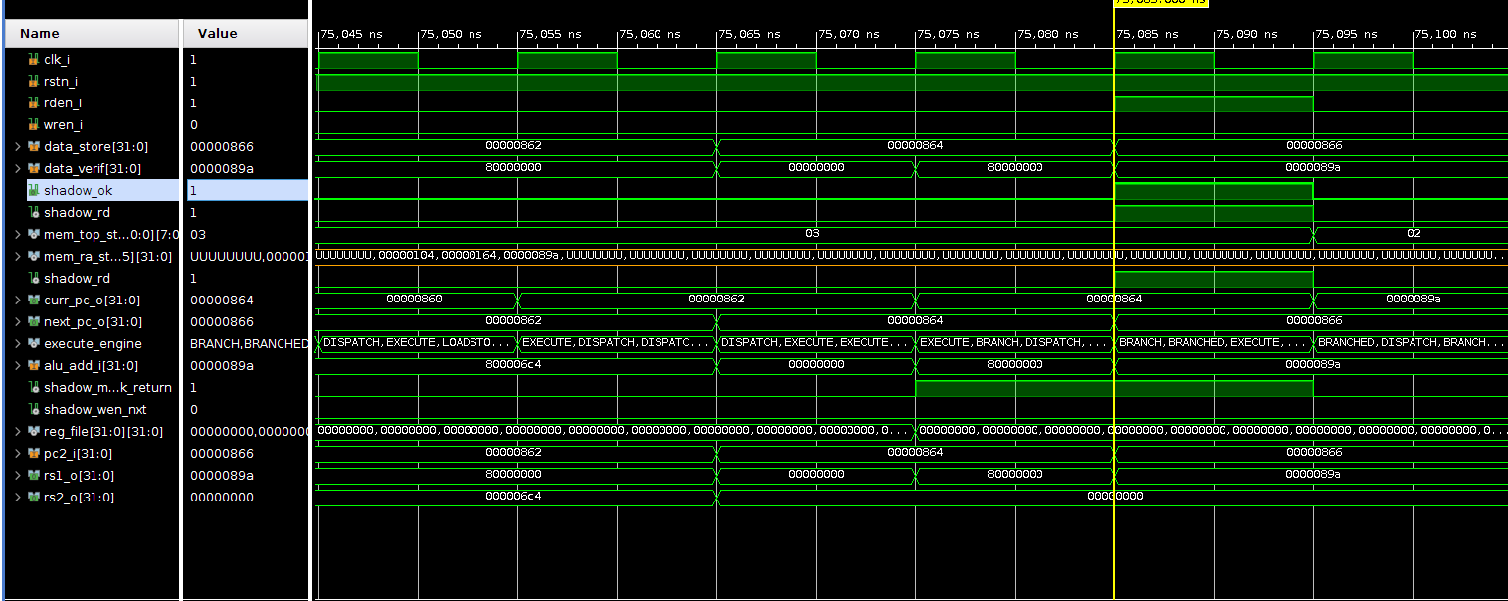
Testbench working

Slide 18
Issues
After a long debugging process: we can generate a bitstream.
The shadow stack seems to work in the testbench.
But the bootloader does not run on the board, possible explanation:
👥There is a kernel/user transition that switches context
🦘There is a jump without return somewhere
🤯Unforeseen explanation

Slide 19
Possible solutions
Presence of a trap handler:
It's likely that the problem is caused by a trap call.
Solutions:
🔐Adding a Control & Status Register (CSR) that manages the activation and deactivation
🔗Using an existing CSR that reflects this behavior.
📝Adding an enable instruction.

Slide 20
🤼 Project organization
Clear plan elaborated in the first semester
Team meetings to work on the project plan tasks that can be done at home
Meetup with the teacher every other week
Half mark presentation to show our progress and decide how to move forwards

Slide 21
🕗 Project retrospective
Difficulties
Difficulties paralyzing tasks
Large technical level differences
Strengths
Good support from the teachers
Good team spirit
Great motivation
Technical background thanks to the microarchitecture class

Slide 22

🖼 Figures & links
risc-v https://riscv.org/
chisel https://riscv.org/blog/2021/02/hardware-description-language-chisel-diplomacy-deeper-dive/
neorv32 https://github.com/stnolting/neorv32
nexys A7 https://digilent.com/shop/nexys-a7-fpga-trainer-board-recommended-for-ece-curriculum/
arty A7 https://www.mouser.fr/new/digilent/digilent-arty-a7-100t-board/
vhdl https://memegenerator.net/instance/28501822/i-have-no-idea-what-im-doing-dog-with-tie-vhdl-i-have-no-idea-what-im-doing
[1] https://bellis1000.medium.com/aslr-the-ios-kernel-how-virtual-address-spaces-are-randomised-d76d14dc7ebb
[2] https://www.phoronix.com/scan.php?page=news_item&px=Shadow-Stacks-Linux-AMD

Slide 23
📚 Bibliography
Abadi et al. - 2009 - Control-flow integrity principles, implementations
De et al. - 2019 - FIXER Flow Integrity Extensions for Embedded RISC
De et al. - 2020 - Hardware Assisted Buffer Protection Mechanisms for Embedded RISC-V
Li et al. - 2020 - Zipper Stack Shadow Stacks Without Shadow
Zhang et al. – 2019 - HCIC Hardware-Assisted Control-Flow Integrity Checking

Slide 24
😊 Thank you for your attention Ask away … ⁉️

